Slide 1
1
Introduction to Computers, the Internet and World Wide Web

Slide 2
OBJECTIVES
In this chapter you will learn:
Basic object-technology concepts, such as classes, objects, attributes, behaviors, encapsulation and inheritance.
The different types of programming languages.
A typical C++ program development environment.

Slide 3
1.1 Introduction
1.2 What Is a Computer?
1.3 Computer Organization
1.4 Early Operating Systems
1.5 Personal, Distributed and Client/Server Computing
1.6 The Internet and the World Wide Web
1.7 Machine Languages, Assembly Languages and High-Level Languages
1.8 History of C and C++
1.9 C++ Standard Library
1.10 History of Java
1.11 FORTRAN, COBOL, Pascal and Ada
1.12 Basic, Visual Basic, Visual C++, C# and .NET
1.13 Key Software Trend: Object Technology
1.14 Typical C++ Development Environment
1.15 Notes About C++ and C++ How to Program, 5/e
1.16 Test-Driving a C++ Application
1.17 Software Engineering Case Study: Introduction to Object Technology and the UML (Required)
1.18 Wrap-Up
1.19 Web Resources

Slide 4
1.8 History of C and C++
History of C
  Evolved from BCPL and B in 1970
    Developed by Dennis Ritchie (Bell Laboratories)
  Development language of UNIX
  Hardware independent
    Can write portable programs
  ANSI and ISO standard for C published in 1990
    ANSI/ISO 9899: 1990

Slide 5
1.8 History of C and C++ (Cont.)
History of C++
  Extension of C
    Developed by Bjarne Stroustrup (Bell Laboratories) in early 1980s
  Provides new features to “spruce up” C
  Provides capabilities for object-oriented programming
    Objects: reusable software components
      Model items in the real world
    Object-oriented programs
      Easier to understand, correct and modify

Slide 6
1.9 C++ Standard Library
C++ programs
  Built from pieces called classes and functions
C++ Standard Library
  Rich collections of existing classes and functions
    Reusable in new applications

Slide 7
1.14 Typical C++ Development Environment
C++ programs normally undergo six phases
  Edit
    Programmer writes program (and stores source code on disk)
  Preprocess
    Perform certain manipulations before compilation
  Compile
    Compiler translates C++ programs into machine languages
  Link
    Link object code with missing functions and data
  Load
    Transfer executable image to memory
  Execute
    Execute the program one instruction at a time

Slide 8
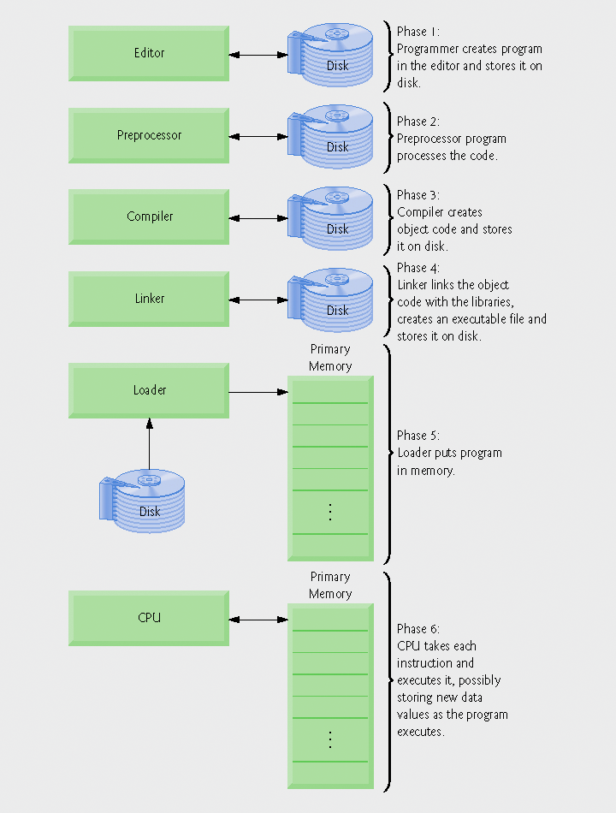
Fig. 1.1 | Typical C++ environment.

